Slide 1

Founder - Raghavendra Katgall
HR:- Suhasini k
Teaching Staf Members
Head of Technology
Name : Anoop Desai
Name : Sakshi Yadav
DESIGNATION : WEB DEVELOPER
Name : Mansi Patil
DESIGNATION : WEB DEVELOPER
TEAM MEMBERS
Abhishek Shintre
Dinesh Jadage
Kishan Mangsule
Ishwar Gandh

Slide 2

Presentation for hospital management

Slide 3
Contents
INTRODUCTION
OBJECTIVES
HARDWARE AND SOFTWARE REQUIREMENTS
TECHNOLOGIES AND LANGUAGES
DATA FLOW DIAGRAM
ERD DIAGRAM
BENEFITS
SCREENSHOTS OF PROJECT
FUTURESCOPE
CONCLUSION

Slide 4
INTRODUCTION
Good hospital management is key to providing excellent healthcare. It means running things smoothly, using resources wisely, and always putting patients first. Today, we'll talk about how hospitals can be managed effectively to improve the health of our communities. We'll explore how strong leadership and smart planning can lead to better patient outcomes. Ultimately, our focus is on building a healthcare system that everyone can rely on.

Slide 5
OBJECTIVES OF Hospital management System
One Patient Record: Securely store all patient data.
Fast Communication: Share info quickly.
Use Resources Smart: Avoid waste.
Get Data Reports: Make better choices.
Better Patient Care: Improve patient experience.

Slide 6
Hardware and software requirements
Hardware:
Processor: Intel Core i5 or higher (AMD Ryzen 5 or higher)
RAM: Minimum 8GB (16GB recommended for smooth development)
Storage: Minimum 256GB SSD (512GB SSD recommended for faster performance)
Graphics Card: Integrated GPU (Dedicated GPU optional for better performance)
Internet Connection: Stable broadband connection for API calls and dependencies
Software:
Operating System: Windows 10/11, macOS, or Linux.
Code Editor: VS Code (Recommended).
Database: MongoDB.
Browser: Google Chrome, Firefox (for testing and debugging)

Slide 7
Technologies AND LANGUAGES
FORNTEND
REACT
JAVASCRIPT
CSS
IDE
Vscode
Notepad
BACKEND
MONGODB
JSON
React

Slide 8
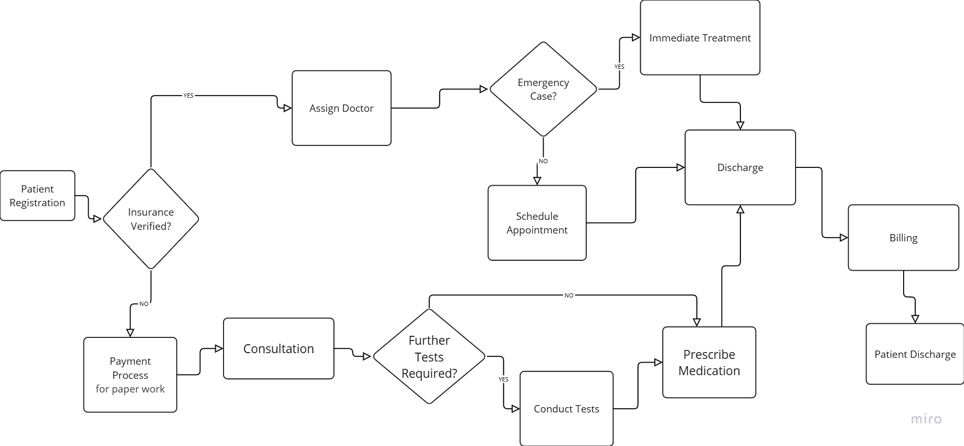
Data flow diagram of hospital management

Slide 9
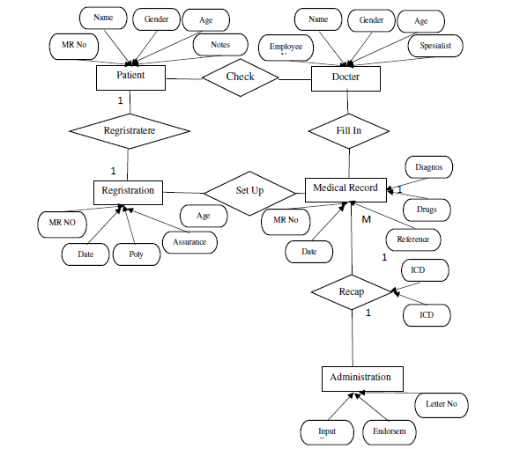
Er diagram for hotel management.

Slide 10
Benefits
Improved Patient Care– Ensures timely medical attention and treatment.
Better Resource Management-Helps in managing medical staff, equipment, and hospital resources efficiently.
Financial Efficiency-Streamlines billing and insurance claims processing.
Data-Driven Decision Making-Enables real-time data collection for informed decisions
Enhanced Patient Experience-Offers faster service and personalized treatment plans.

Slide 11
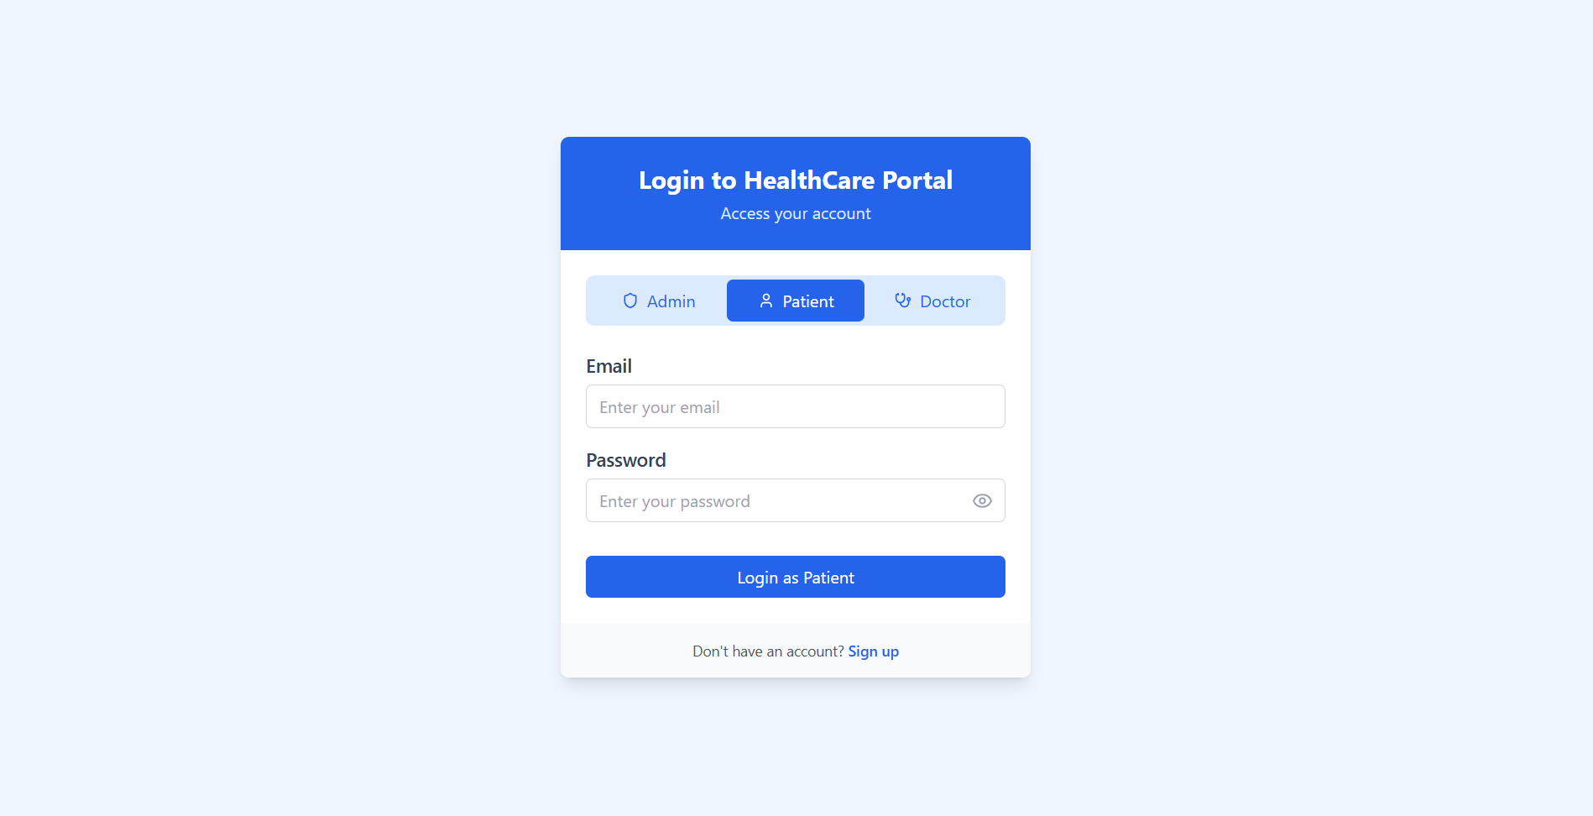
Sign up or register page for ADMIN,DOCTOR,PATEINT

Slide 12
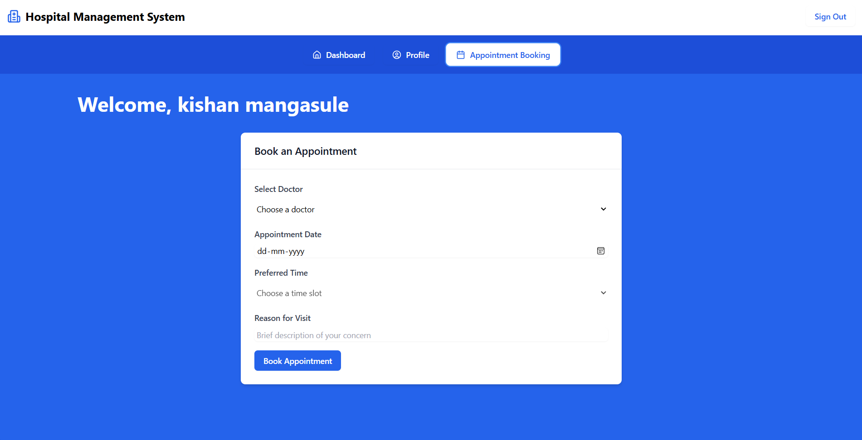
Appointment booking

Slide 13
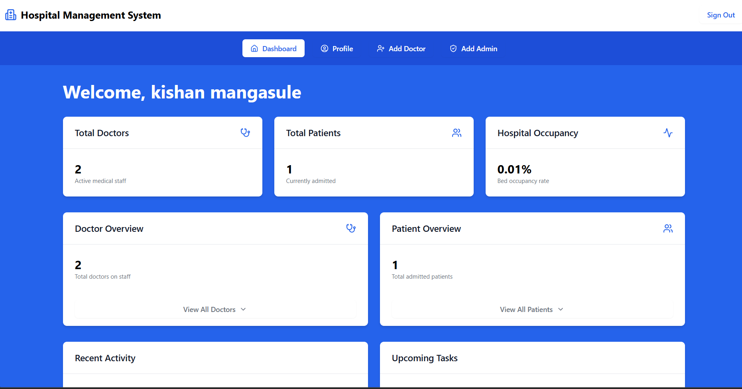
ADMIN dashboard

Slide 14
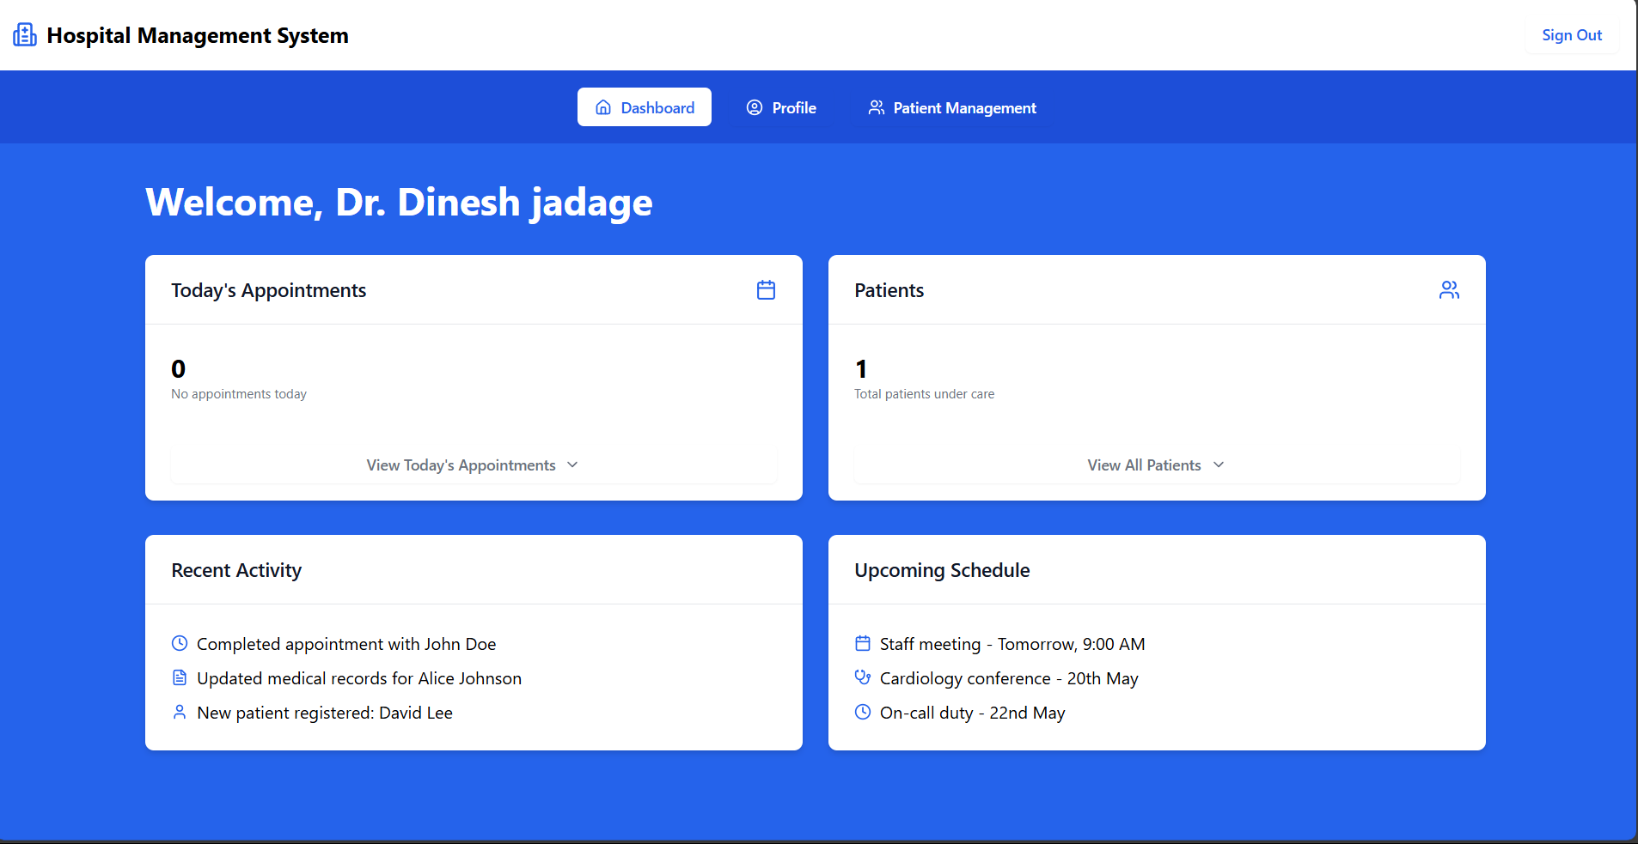
Doctor dashboard

Slide 15
Future scope for hospital management
Tech in care: Using new tools to help patients.
Data for health: Using information to make better choices.
Care for you: providing treatment to individual needs.
Stay healthy: Stopping problems before they start , If we knew.
Care for all: Making sure everyone can get help.

Slide 16
Conclusion
To sum up, running a hospital well is really important. It means making sure patients get good care, using new ideas, and always trying to do better. When hospitals are managed right, everyone gets healthier and our communities are stronger. We hope every individual patients should be cured.

Slide 17


